Slide 1
Project Auntie
Project was part of Metropolia’s Innovation project -course. In short, the teams were asked to create a concept for Auntie’s mobile service, including visuals, functionality and business model.
Auntie gave us a brief presentation what Auntie is all about, and what it is that they expect from this project. After the presentation me and others asked a bunch of questions, relating to their customers, their brand and image and the psychotherapy packages they provide.
Read the whole report from: https://drive.google.com/file/d/0Bwnz7lD4I74iLWk4NDlJZkV5akE/view
Role in group work:
Ideation, Innovation, service design
Individual role:
UI/UX design
defining business model and value proposition

Slide 2
Process of the project
Kickoff and meeting with Auntie CEO
Defining the project and task at hand
Ideation and design
Making the final prototype
Gathering information about:
Auntie and their service
Provided therapy packages
Their clients and users
Combined gathered information and paint more clear picture of the project
Team got together on wednesdays to ideate and develop the consept
Define features and user flow
Define visuals
Defined:
Between the meetings, all members of the team were given a task (someting to do or investigate)
Build an early prototype
What should the service provide and what is it for
Who are the users and what are their goals
What should the content be (features, exercices)

Slide 3
What is Auntie 1/2
Auntie provides low threshold, remote psychotherapy packages for companies (B2B).
The employer pays for the service, while the employees are the end-users.
Revenue model
Auntie’s therapy packages include five remote therapy sessions, one 45-minute session per week, and three 15-minute follow-up calls.
The cost of one package is 490 € and the price is always the same, regardless of the chosen package.

Slide 4
What is Auntie 2/2
Clients
B2B
Companies that take care of their employees (brand and image, Best Places to Work)
End-users
80% women
30 to 50 years old
Working at offices
Demanding jobs
Have an academic education
Brand / Image
Fun and laid-back
(Tries to separate themselves from the traditional therapy services)
Use of current service
Remote therapy sessions are accessed mostly from mobile devices and during working hours
Competition
Mehiläinen and other private healthcare providers that provide psychotherapy
Possible competition for the online service
Mind-fulness and mediation apps
(Fabulous, Headspace, Happify)

Slide 5
Discovered issues
Lack of automation and digitalization
Sending emails is required, when customers are getting started with service (Invoicing and managing users is done by email)
Information from the users is not gathered in one location, but through the therapist or by email. (information includes progress of the end users and feeling from the therapy)
Managing and utilizing gathered information is poor
Suggestion of exercises is done by the therapist, which takes might take excess time
Lack of privacy
To enroll for Auntie’s therapy service, employees must ask it usually from HR. This reduces privacy of the employees and can make the threshold for participating, higher.

Slide 6
Solution platform to support the main service
Provides a platform to base all the necessary tasks, exercises and processes to carry through a successful remote therapy service.
Provides a platform where user information can be gathered, collected and shared more easily.
This enables faster and easier implementation of the service, makes sending emails back and forth a task of yesterday, and keeps customers and Auntie more organized.
Solution enables users to sign up for Auntie’s therapy packages without any face-to-face action.
This makes the process faster and more manageable, and it could also lower the threshold for employees.
Invoicing and managing users is done via online service

Slide 7
Solution Service/ User flow
Auntie makes a contract with the company.
Identification key is provided to the company, so that Auntie can recognize for whom the employee is working for and grant access to the online service.
By using the identification key, every employee of the client company can access the online service, activate their personal account and start using the service.
User fills out a start questionnaire in the online service relating general mental state, relationships, hobbies, state of life etc.
Employer can advise employee to sign up for a therapy package with an email invitation sent via Auntie’s online service. Employee can also sign up themselves without an invitation. Threshold for the employees to participate is lowered when contacting is done online, with no face-to-face contact.
Employee chooses a therapy package suited for himself with the help from Auntie.
Based on the chosen package and using the information from the questionnaire, Auntie chooses two Times (segments) from the online service, from which the user should perform tasks and exercises from. This part could be partially automated in the online service.

Slide 8
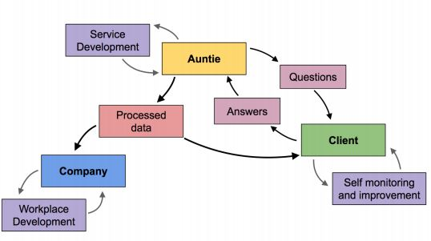
Solution Information management
How to organize gathered information and utilize it
As the information about the end-users can be more easily gathered it should also be utilized as much as possible.
Auntie should use it to improve their therapy services and procedures, companies should use it to improve their work environment and employees, and the end-users (clients) should use it to monitor their progress.

Slide 9
Solution Business model
Therapy and online service in the same package
Online service is going to be provided as a part of Auntie’s existing service and included in the therapy packages with the same price.
Stay on B2B
The leading idea of Auntie’s business model, for providing psychotherapy services for businesses is going to be kept the same (B2B).
Our team didn’t see any reasons to expand to the private customer market, as there are more competition and numerous cheaper/free alternatives already available.
We also saw that B2B is a more stable market and that companies would have an interest for providing Auntie’s services to their employees, for preventing sick leaves and enhancing work efficiency.
Aim for terminable contract
A potential issue with Auntie’s current business model is the unpredictability of new clients and the revenue stream.
This issue could be addressed by making a terminable contract with a company, for 6 to 24 months with a fixed base price. The value of the contract should be constructed so that every employee is offered a fixed amount of therapy packages to sign up inside the agreed timeline.
This solution should ensure the revenue for a longer term and enable Auntie to plan further into the future.

Slide 10
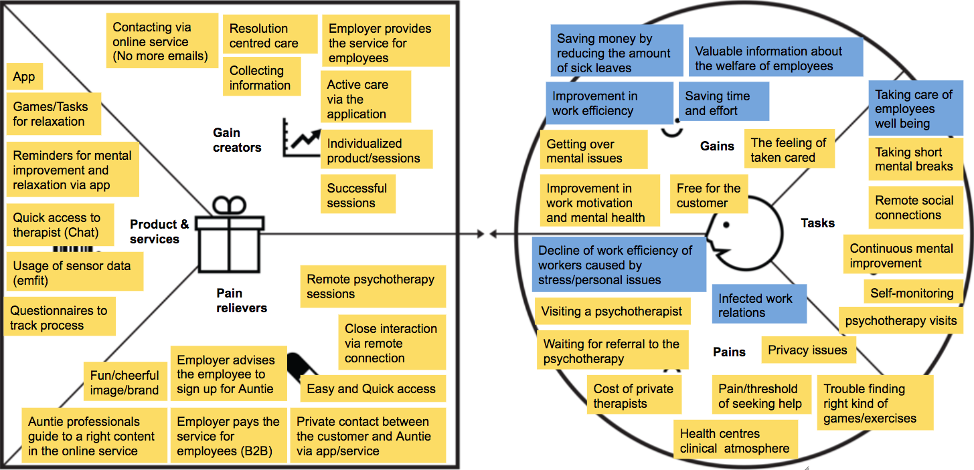
Solution Value proposition
Value proposition canvas is put together with both the employers and employees in mind, as both sides benefit from Auntie’s service. It shows what value Auntie’s future servicegives to their customers, and also what are problems it solves and how are they beingsolved.
On the left side is Auntie service that answers the pains, gains and tasks, set bythe customer on the right. On customers side, blue colored boxes represent employer,while yellow ones represent the employee.

Slide 11
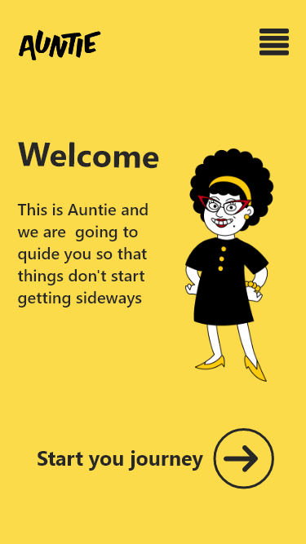
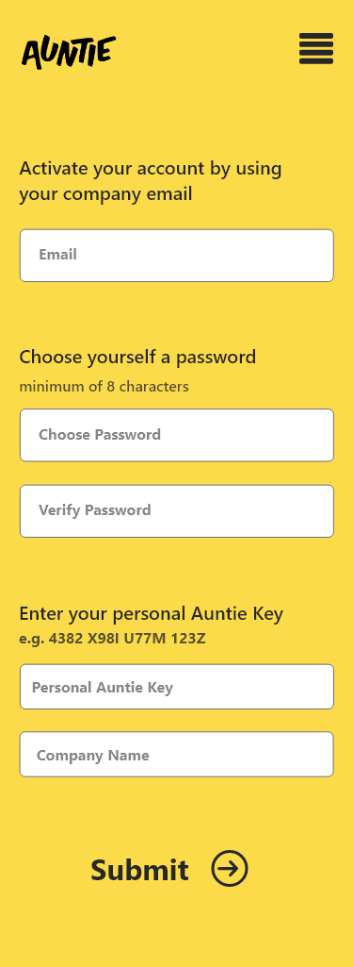
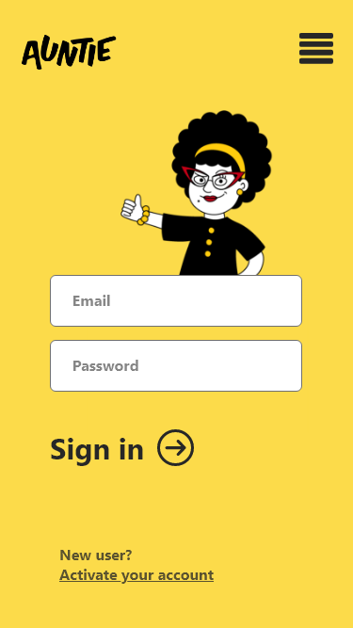
Solution Mockups
Visual references (Character and colors) were provided by Auntie and based on their existing brand.
Start of the journey
User starts the journey on activating their account on the online service
Identification is done with company name and email, and ”Auntie Key” that are submitted
Password is chosen by the user.

Slide 12
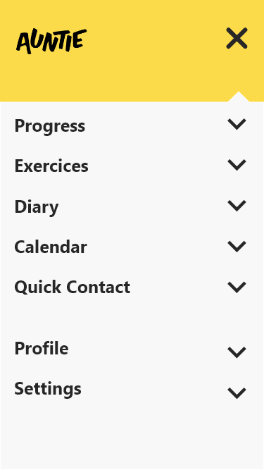
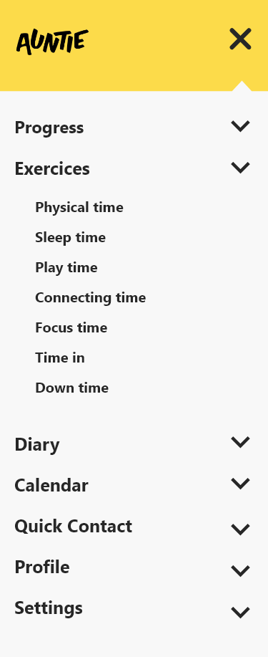
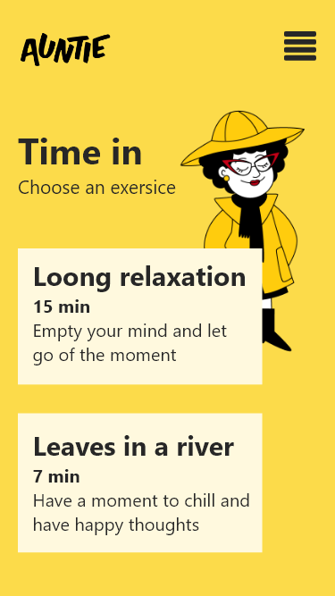
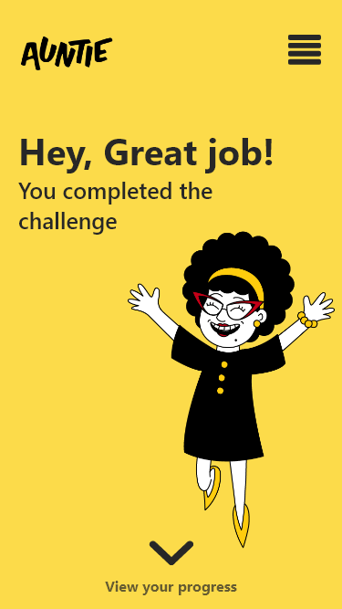
Solution Mockups
Choose an exercise
On this design, exercises are accessed from main navigation
Exercises are grouped based on the seven areas of life. The methology from Aunties’ therapy sessions
After compliting an exercise, users can view their process and history

